Slide 1
Giving for Good: Simple Giving In a Complicated Time
2021 UWCFD Campaign Coordinator Training

Slide 2
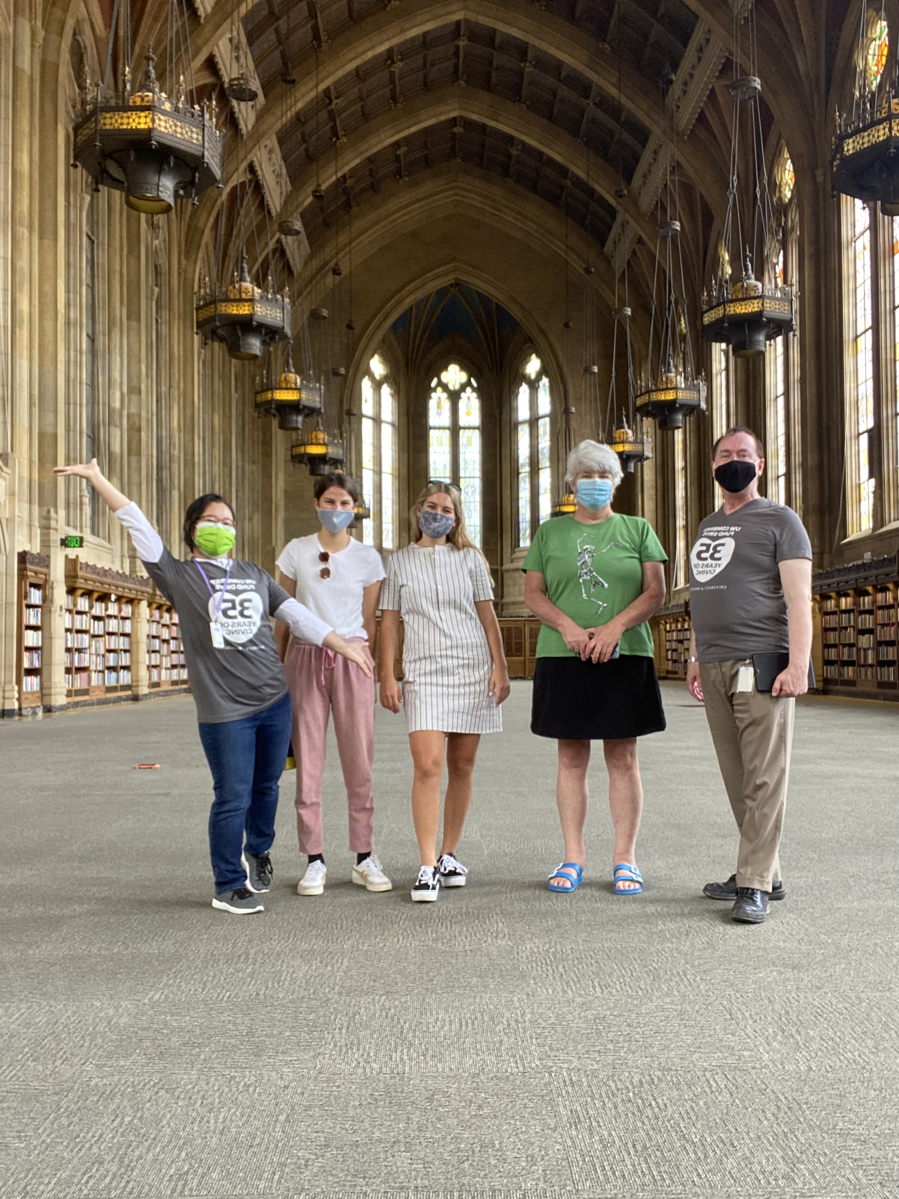
Thank you for being a campaign coordinator!
UWCFD campaign coordinators are the key to a successful campaign. This role is vital in maintaining robust nonprofit organizations and healthy communities.
2021 campaign assistants at the Suzzallo Library reading room during a campus tour

Slide 3
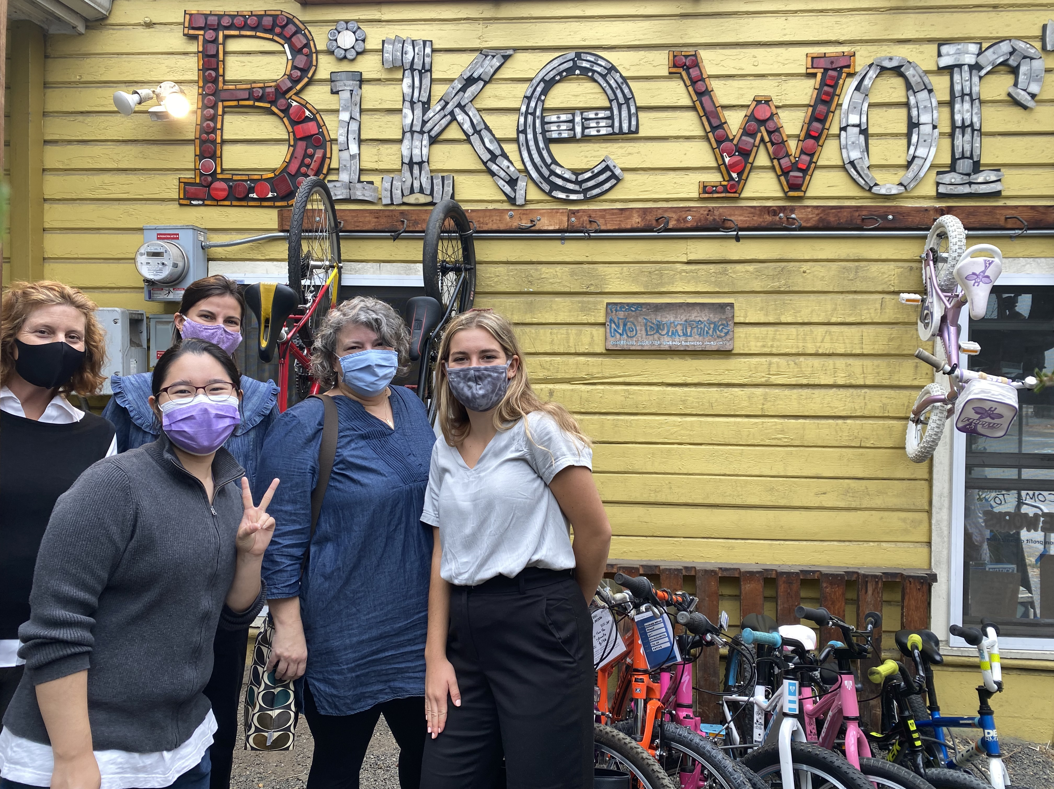
Contents
History and mission of the campaign
Meet the UWCFD team
Coordinator information
Important dates
What is simple giving?
UWCFD campaign assistants and staff tour Bikeworks, a Seattle-based nonprofit

Slide 4
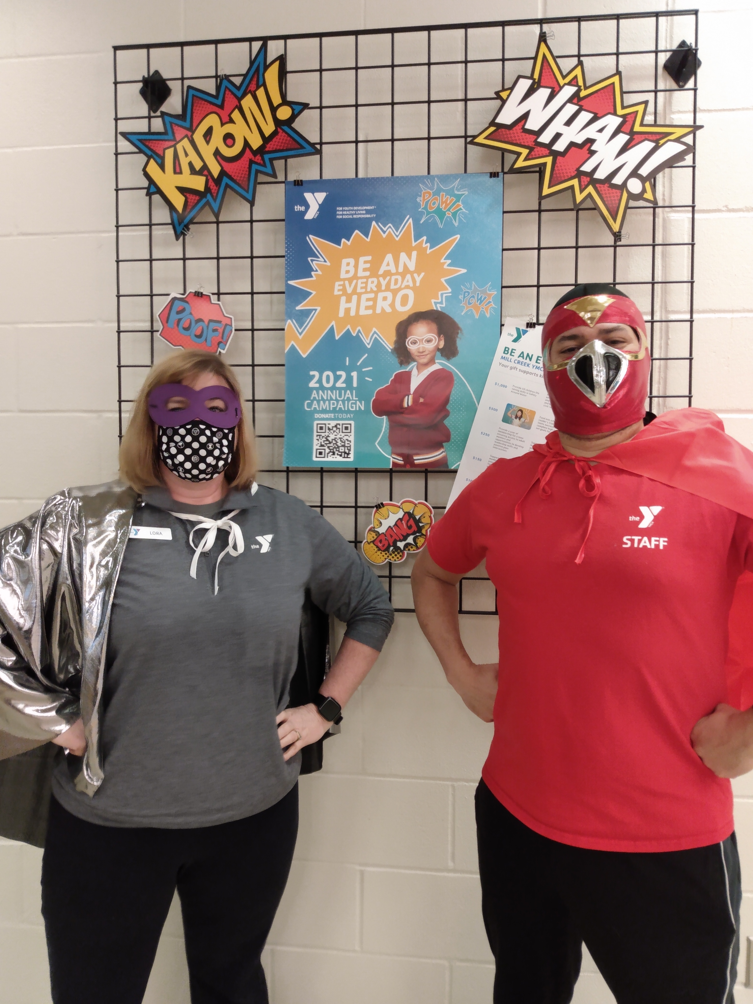
What is the Combined Fund Drive (CFD)?
The CFD is Washington state’s workplace giving campaign, providing employees and retirees the opportunity to make a significant impact in their communities and change people’s lives.
Snohomish County YMCAs held a “superhero” week during their 2021 annual campaign

Slide 5
Mission of the Campaign
Empowering Washington state public employees and retirees to strengthen communities through the funding and support of charities.

Slide 6
37 Years of Giving for Good
The CFD was founded in 1984 – the same year that produced such iconic movies and albums as:

Slide 7
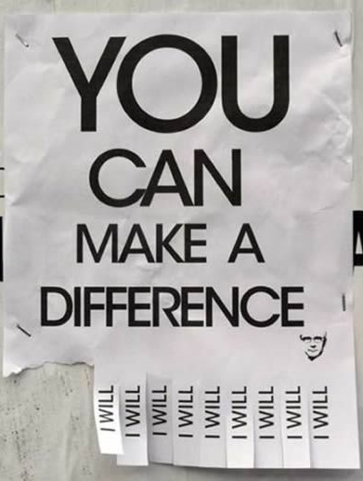
History of the Campaign
Since 1984, state employees and retirees have raised more than $150 million for nonprofit organizations, of which more than $52 million was UW pledges.

Slide 8
Meet the UWCFD Team
Jolyn Mason, Campaign Manager
Jolyn became the UWCFD Campaign Manager in 2020 after with the campaign in a variety of capacities for many years. She is the Chair of the UWCFD Events Committee and serves on the Sno-King CFD committee and the Washington State CFD steering committee. A long-time Seattle resident, Jolyn enjoys reading, knitting, cooking, yoga, spending time with family and friends, and gardening. And coffee.
jolynm@uw.edu
206-616-5437

Slide 9
Meet the UWCFD Team
Nicole Reeve-Parker Workplace Giving Specialist
Nicole joined the UWCFD team in 2020, having volunteered as a campaign coordinator for several years and worked as a campaign assistant (with Jolyn!) for the 2010 campaign. A Seattle native, Nicole enjoys reading, running, traveling, family time and - like Jolyn - lots of coffee.
nicolerp@uw.edu 206-616-3678

Slide 10
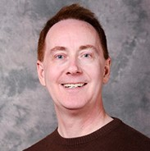
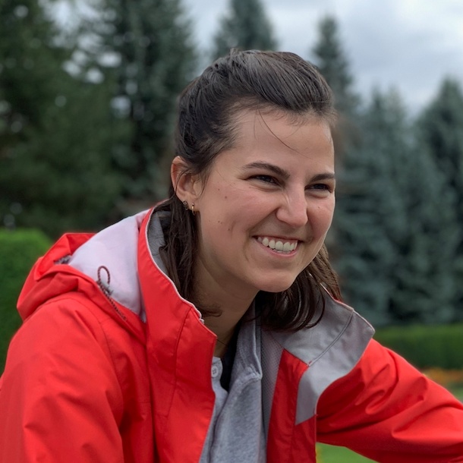
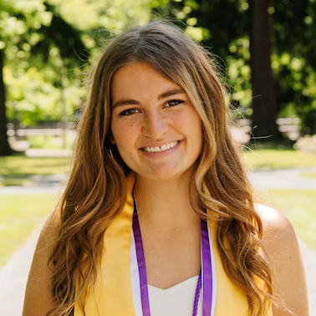
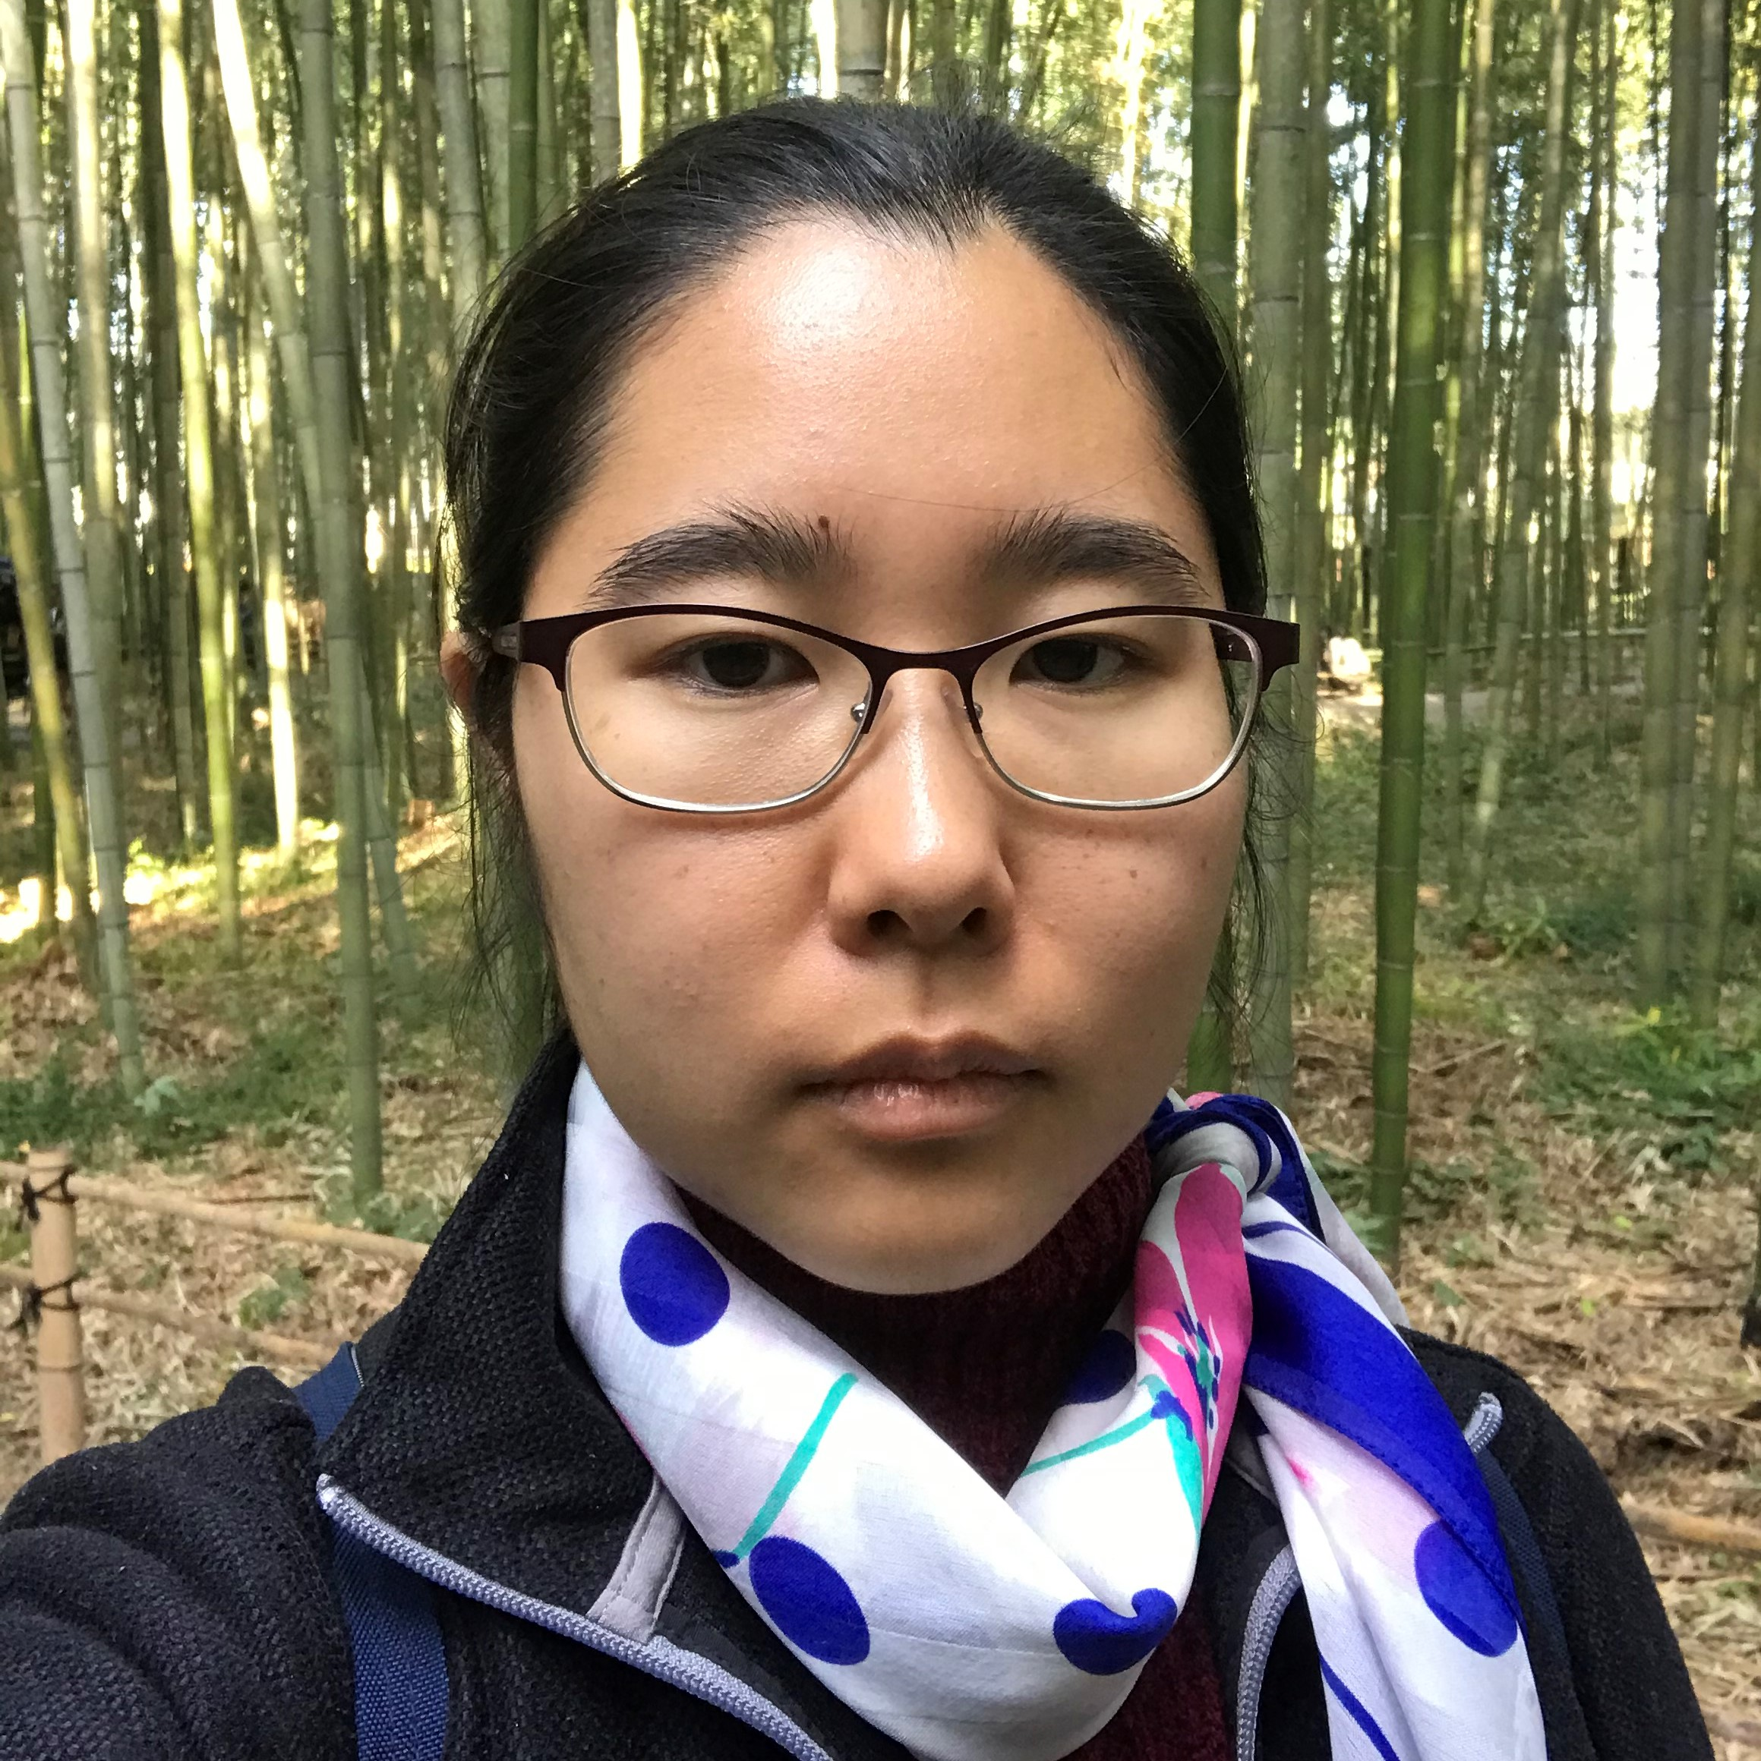
Your 2021 Campaign Assistants
Dean Speer
Kate Montebello
Annabel Weyhrich
Camille Nagasawa

Slide 11
You’re the Campaign Coordinator!
What does that mean?
You will plan your campaign, share information with your colleagues, and let them know how easy it is to give.

Slide 12
Good News for Coordinators!
The UWCFD is an official part of state business. What does that mean? Volunteers (you!) are allowed to work on the campaign during business hours. Be sure to get your supervisor’s approval for your campaign plan.
For the data lovers in the crowd, you can review WAC 434-750-010 - 434-750-300 for specific rules surrounding the campaign.

Slide 13
2021 Campaign Theme
#GivingforGood

Slide 14
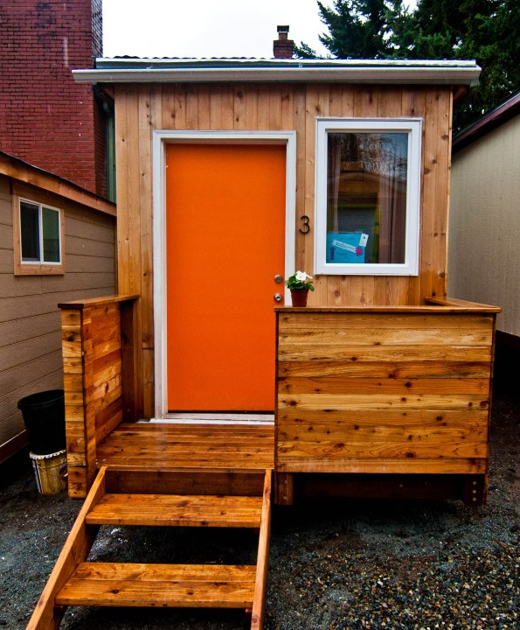
2021 Featured Nonprofit Low Income Housing Institute’s (LIHI) Tiny House Villages

Slide 15
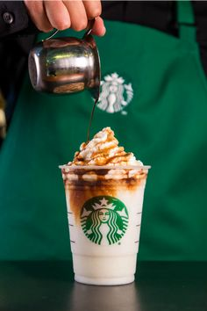
Campaign Dates: October 4 – December 3, 2021
First week to give is October 4 -10
New and returning donors can earn a $5 Starbucks card compliments of WSECU
Make a pledge of $5 or more or add $5 or more to an existing donation
Volunteer for a minimum of one hour for a UWCFD member charity and track the hours using the CFD Volunteer Tracker

Slide 16
Why CFD?
Benefits to employees
All your tax-deductible charitable giving is in one place, conveniently listed for you on your annual W-2
Make a bigger difference by making a larger overall gift in smaller increments
Make changes to your giving anytime, from any device
Respond immediately to developing situations or shifting priorities
All charities are vetted by the Office of the Secretary of State

Slide 17
Why CFD?
Benefits for nonprofits
Workplace giving provides a reliable source of revenue. Organizations get a quarterly disbursement so they can plan around those resources.
We are an open campaign and add new organizations year-round. If you can’t find your favorite organization, we can work with them to join the campaign!
Low administrative costs! Overall, the Combined Fund Drive is the most efficient way to raise large amounts of money at a very small cost and assures the maximum possible funding goes directly to charities.

Slide 18
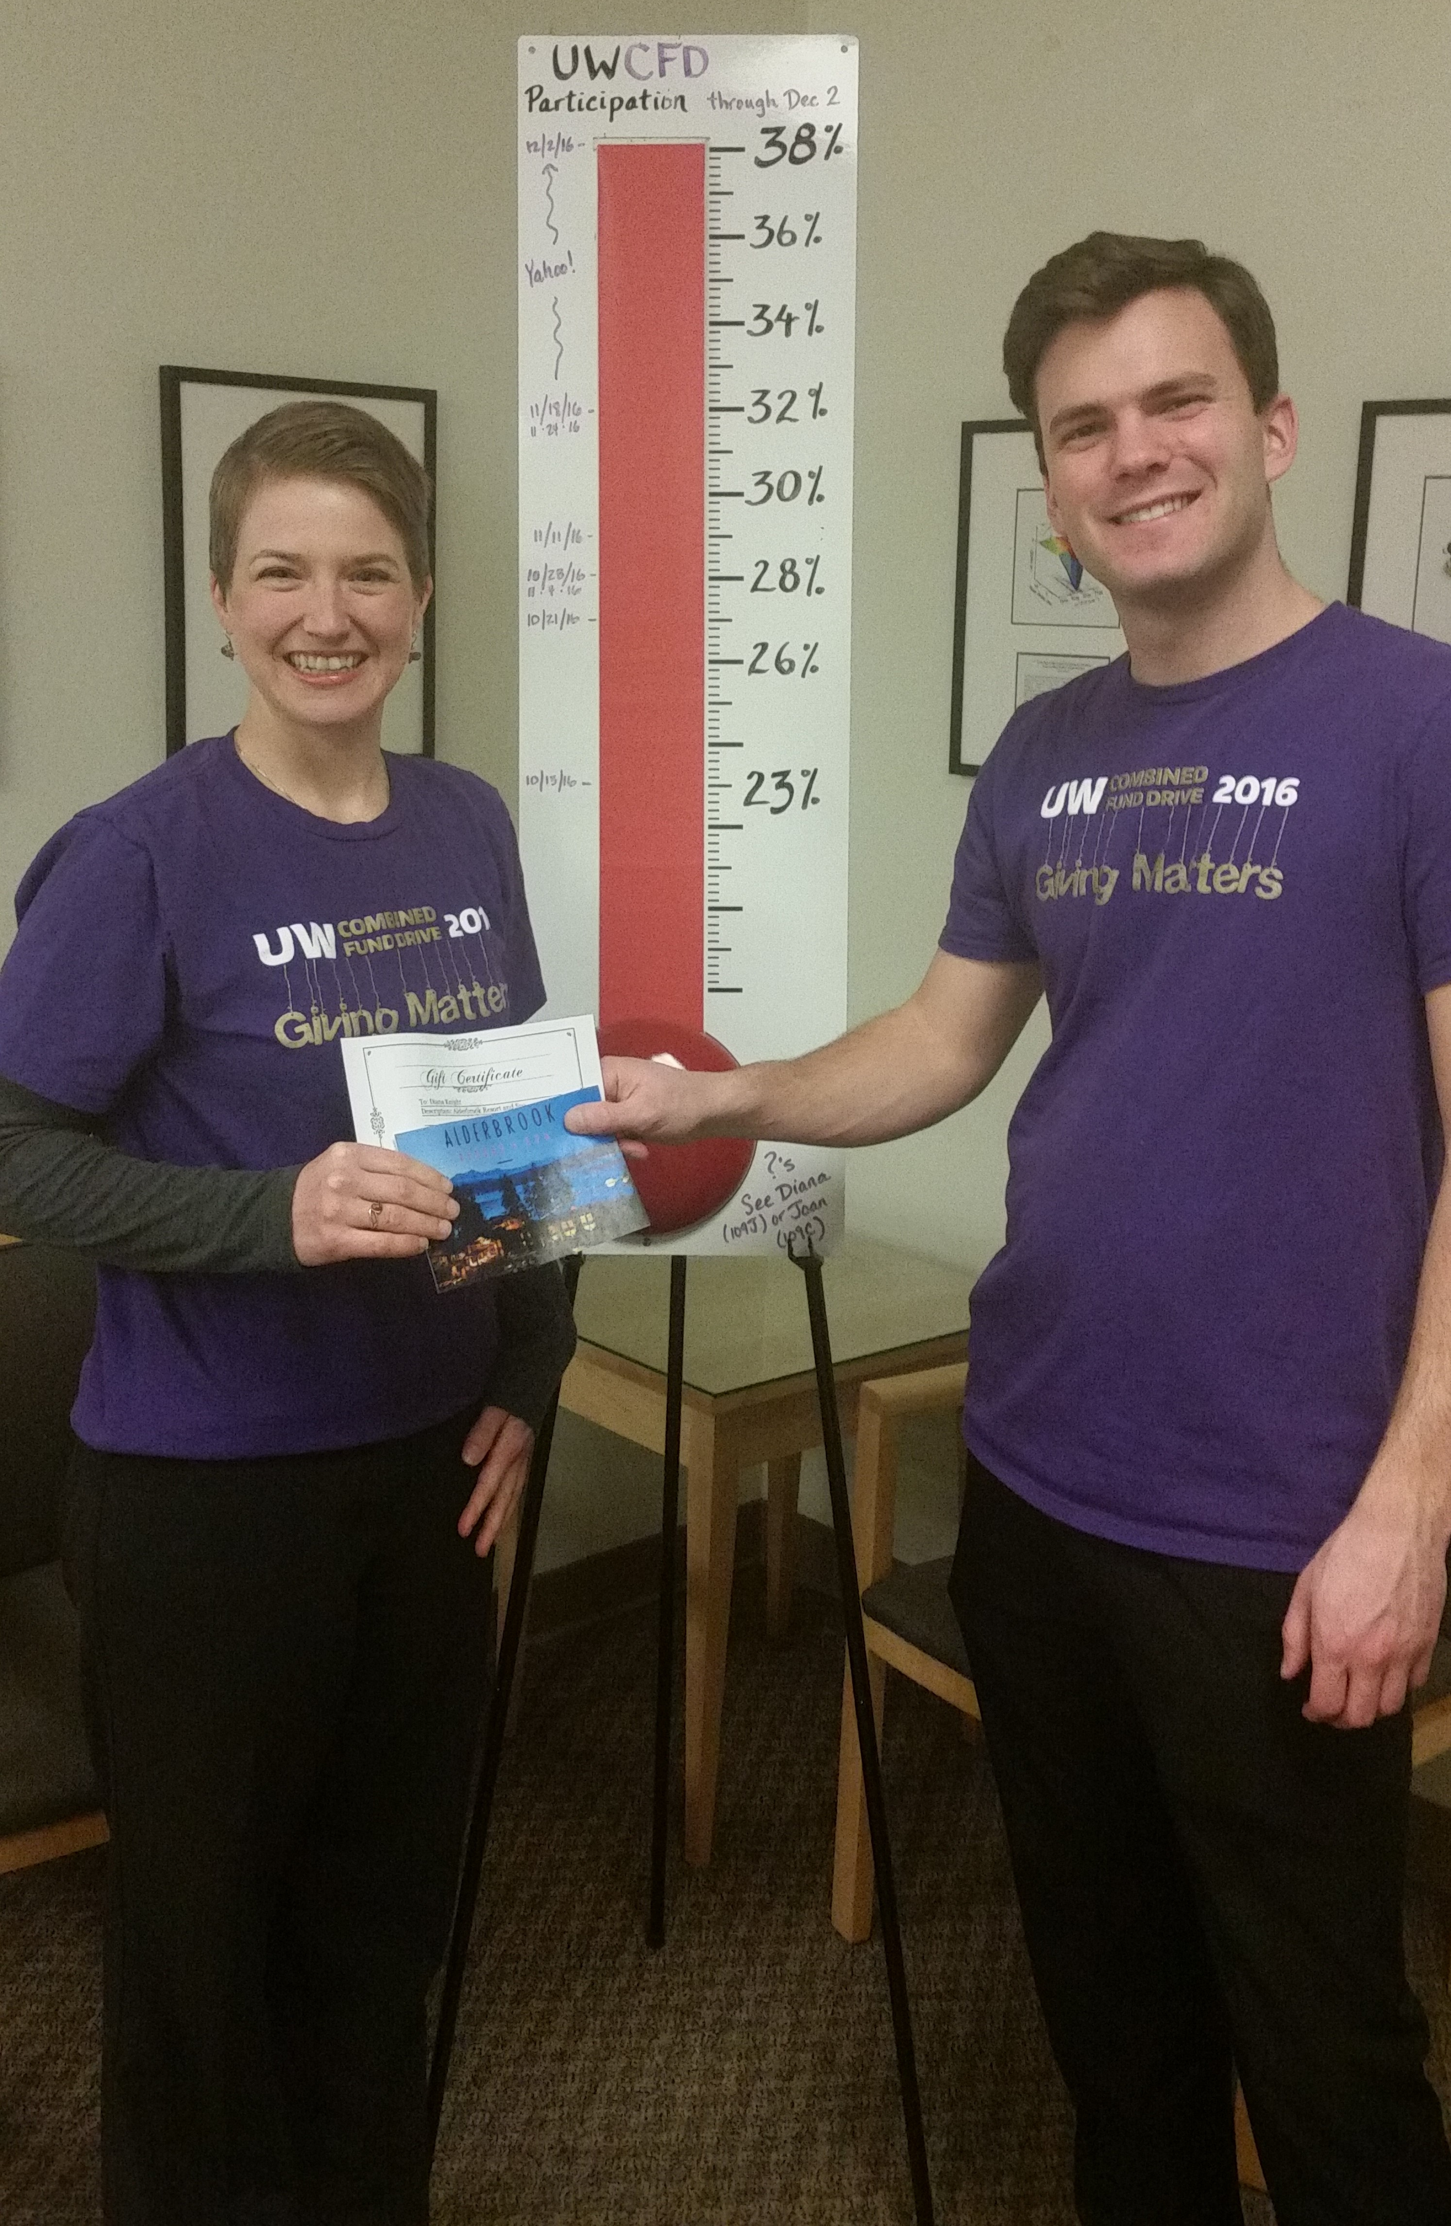
Coordinating a UWCFD campaign is fun and easy
The giving process is simple: most UWCFD donors give through payroll deduction, which can be set-up online in minutes.
Donors can also write a check and send it through campus mail with a giving form
The impact of our collective giving is enormous! All our gifts together add up to a big difference for communities – locally, nationally and around the world.

Slide 19
Value of Workplace Giving
Customize your campaign to match the culture of your office – what do your colleagues want to see or read or do?
Lunch & learn with charitable organization reps
Volunteer and/or nonprofit spotlight in your newsletters
Social media challenges and contests
Donation drives – virtual or on-the-ground
You set the game plan and we’ll help you make it happen!

Slide 20
Value of Workplace Giving
Engage your co-workers and enhance common culture
Create shared goals
Update your progress
Celebrate your successes
Applaud your colleagues’ involvement
Let people know how they are making a difference

Slide 21
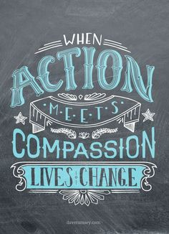
Volunteer!
Employees can also volunteer their time to support their favorite nonprofits. The gift of time has an average value of $30.46 per hour!
The Volunteer Tracker tool, located in the individual’s CFD account, can be used to track volunteer hours with CFD charities.

Slide 22
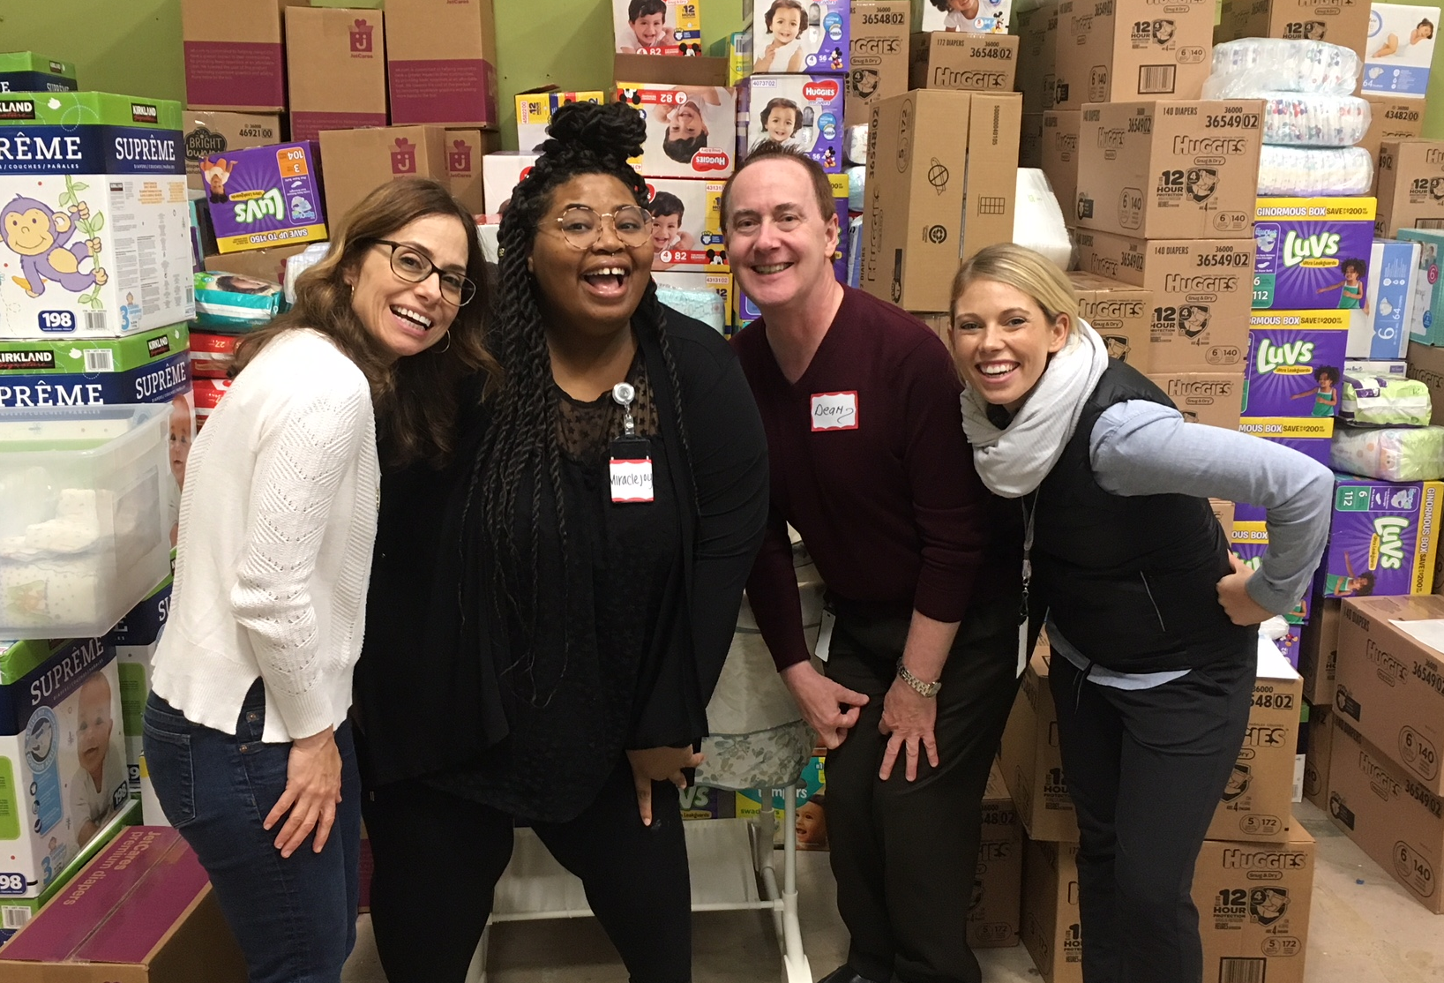
Resources for Coordinators: People
One of the great things about this campaign is all the structure in place - you’ve got a team to help you out:
Campaign Assistants and UWCFD staff
Your manager and co-workers
Past coordinators
2018 Campaign Assistants at a diaper drive for WestSide Baby

Slide 23
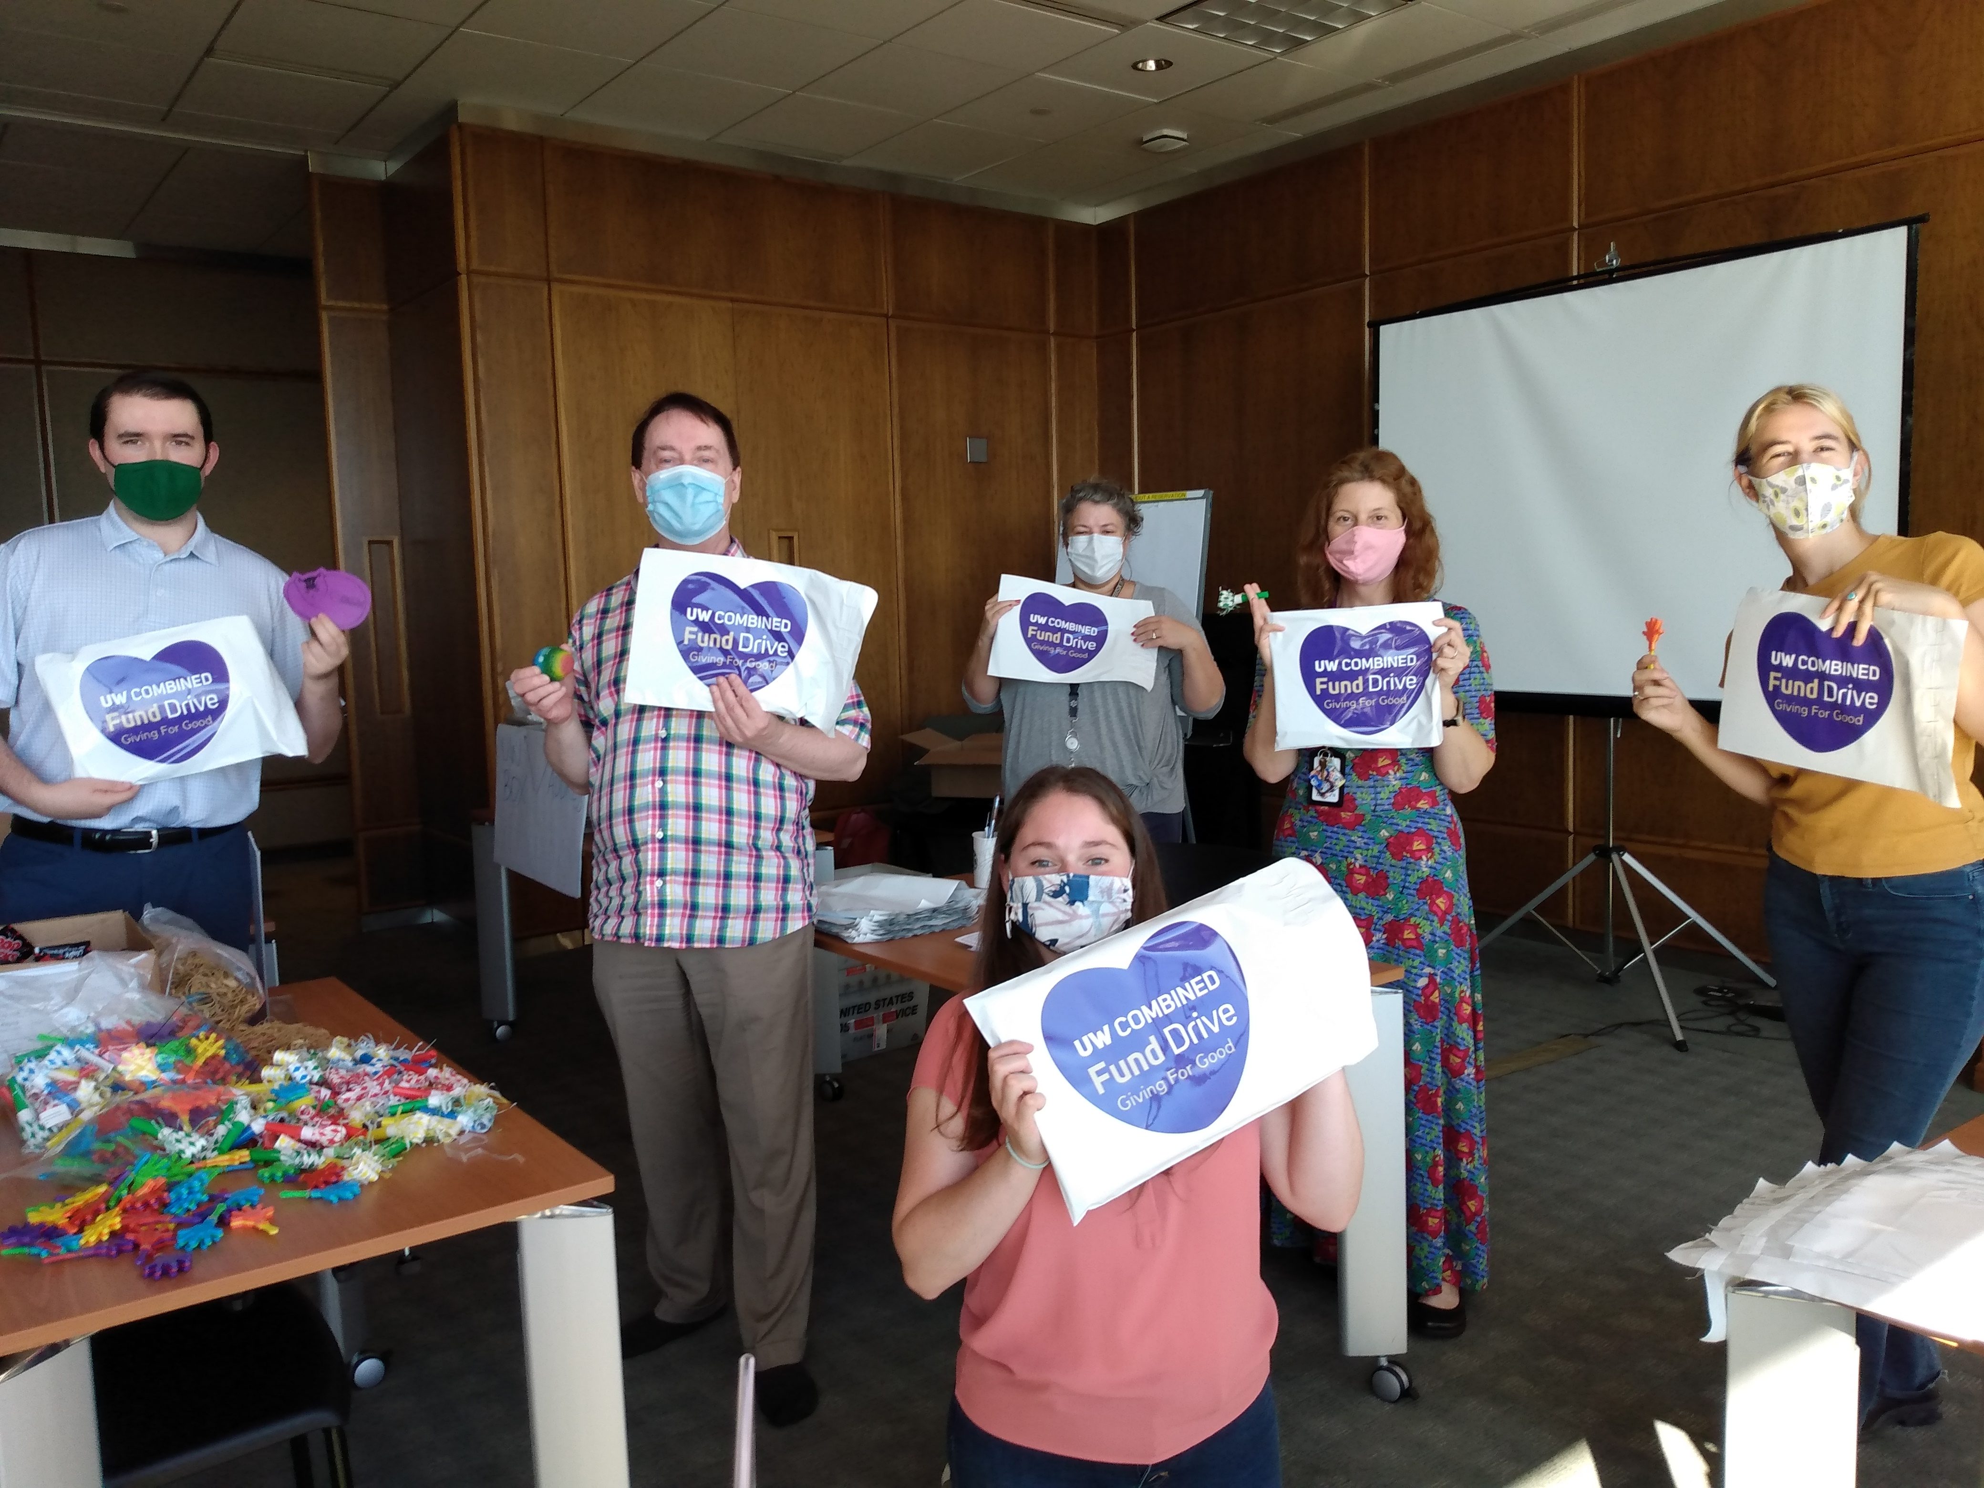
Resources for Coordinators: Toolkits
You have various resources available to you on the CFD website or through your campaign assistant:
Promotional materials
Fundraiser guidelines
Nomination forms
Impact statements

Slide 24
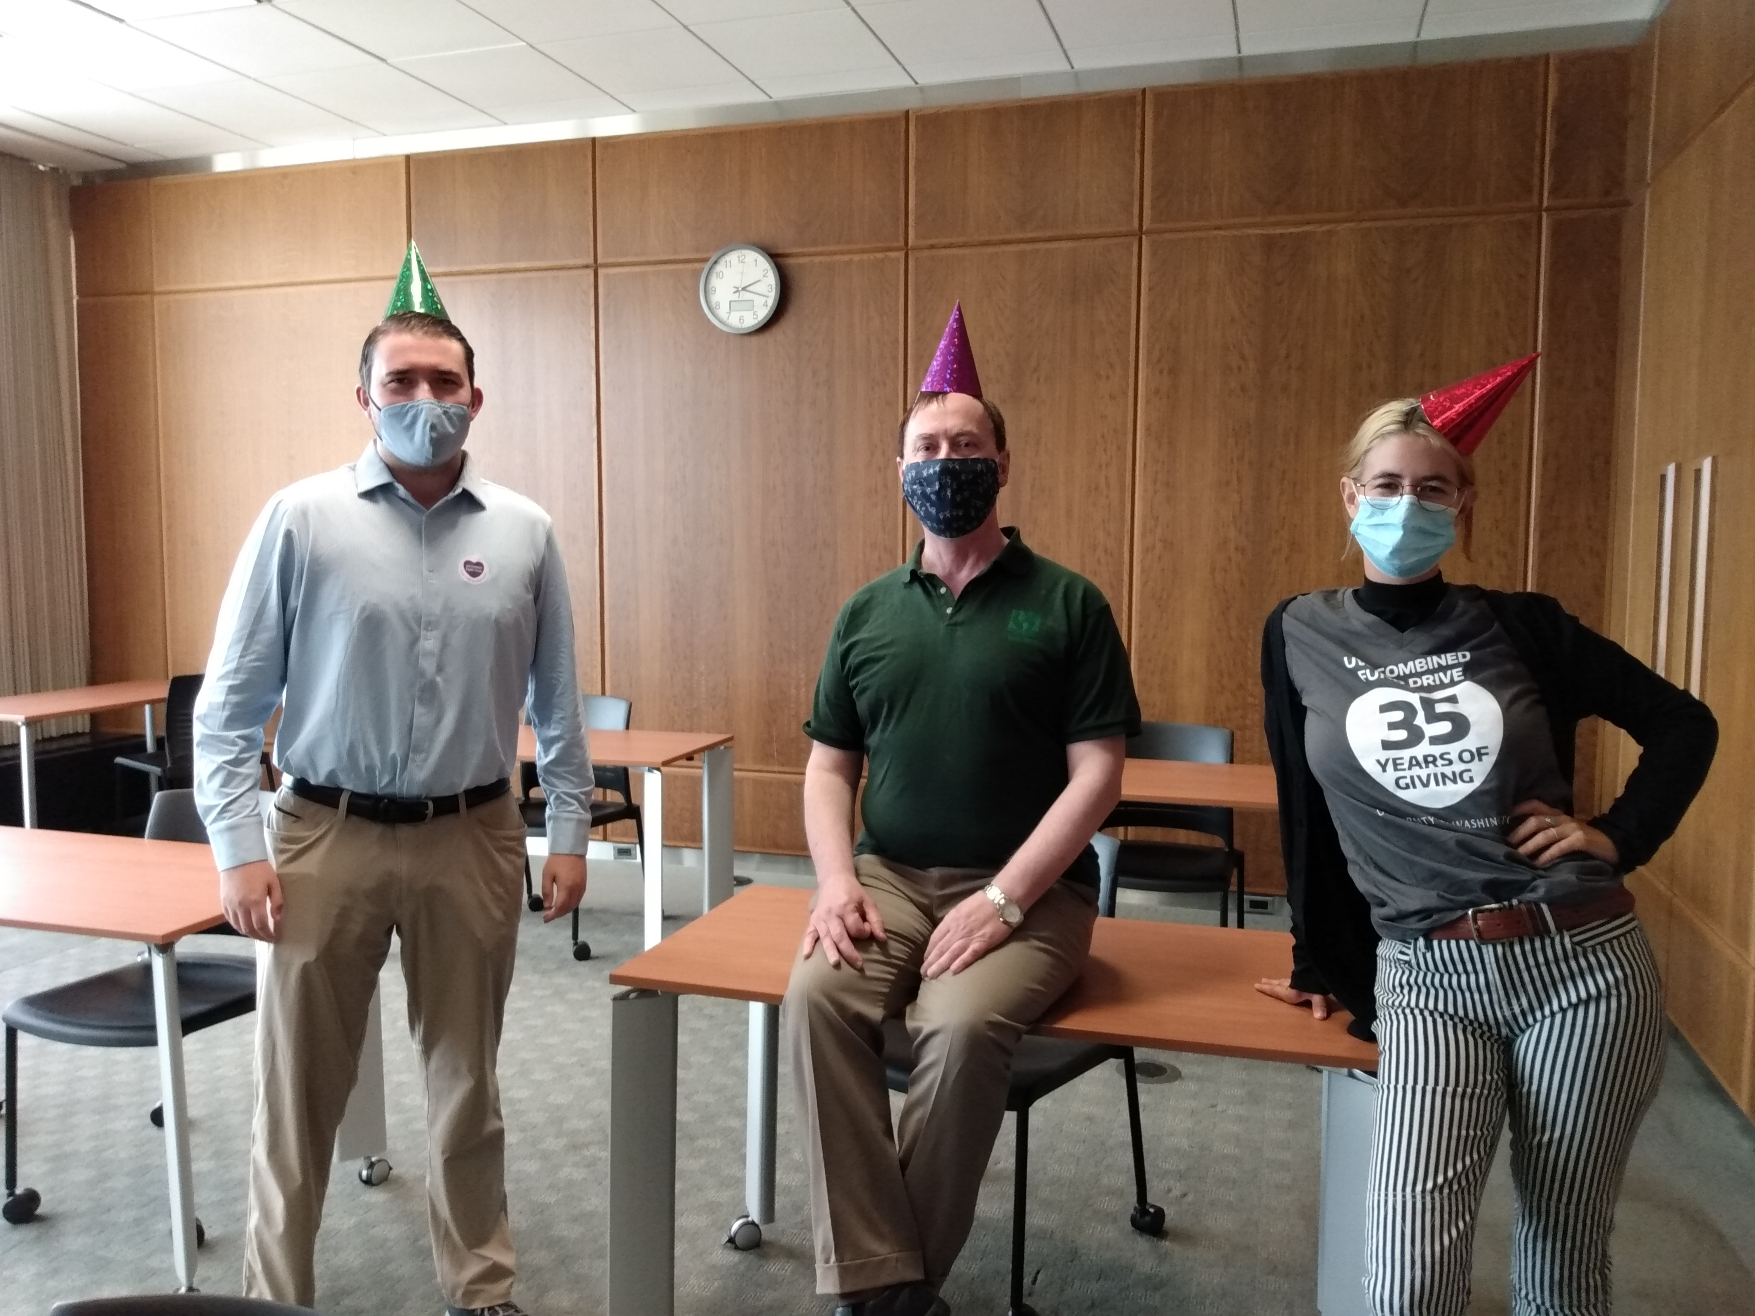
Join the UWCFD Events Committee!
The UWCFD Events Committee includes volunteers from across campus and representatives from local charities who work year-round on strategic planning, on events such as:
Annual nonprofit expo
Coordinator kickoff
Volunteer recognition

Slide 25
Campaign 2021 Events
First week to give coffee card promotion
Virtual nonprofit expo, Tuesday October 12
Weekly lunch & learn seminars starting Oct 7
Virtual auction, October 12 – 18
Holiday wreath sale to benefit LIHI Tiny Houses
Last week to give promotions and giveways

Slide 26
Have questions? Need more resources?
Reach out to your campaign assistant anytime you need assistance! You can also contact the UWCFD office at uwcfd@uw.edu or 206-616-3678.
THANK YOU!

