Slide 1
LABOR RELATIONS 101: Collective Bargaining Basics
University of Washington

Slide 2
Objective
By the end of today’s training, you will have learned more about your collective bargaining responsibilities and explored ways to avoid grievances and unfair labor practices.

Slide 3
Labor Relations
By the numbers
30,000 (approx.) union-represented UW employees
19 union contracts
11 unions
6 negotiators
Key roles
Collective bargaining including administration of contract
Grievance and arbitration administration
Strategic advising and training
Contract interpretation

Slide 4
What it Means for Employees to be Represented
The Union and Employer negotiate terms and conditions of employment – Collective Bargaining Agreement (CBA).
The union acts as the employees’ representative in issues with the employer.

Slide 5
Managing in a Union Environment
The secret to managing in a Union environment...
Identify how you would communicate, build trust, and maintain relationships with people in normal life.
DO THAT!
BTW, there is no secret...

Slide 6
Managers are responsible for:
Knowing if your staff are represented by a Union. ​
Familiarizing yourself with the relevant Collective Bargaining Agreement/s​.
Understanding employees' rights under their Collective Bargaining Agreement/s.​
Working with your HRC or Labor Relations whenever there is a proposed change to an employee's wages, hours, or working conditions.

Slide 7
Why Collective Bargaining?
To promote the continued improvement of the relationship between public employers and their employees.
Labor laws are aimed at protecting the process of communication between labor and management, rather than at prescribing particular results.
Governed by RCW 41.56.010
and 41.80.005.

Slide 8
What is Collective Bargaining?
A process, focused on communication.
Key elements:
Mutual obligation.
Meet at reasonable times as needed.
Confer and negotiate in good faith – this is critical!
Execute written agreement re: mandatory subjects of bargaining (wages, hours, and working conditions), grievance procedures, etc.
Not compelled to agree or make concessions.

Slide 9
Good Faith?
Obligation extends beyond bargaining a CBA.
Engage in full and frank discussions.
Come to the table with honest and sincere desire to reach agreement.
Keep an open mind and demonstrate willingness to consider alternatives and keep an open mind to explore possible alternatives that address interests.
Do not take inflexible positions.

Slide 10
ULPs and Grievances
Unfair Labor Practices (ULPs)
Filed with the Public Employment Relations Commission (PERC) alleging that an employer or union violated state collective bargaining law.
State agency responsible for enforcing collective bargaining laws In WA State.
Grievances
Complaints alleging that an employer or union breached the collective bargaining agreement.

Slide 11
Grievances Are…
Opportunities for dialogue!
Contracts require progressive corrective action.
Informal → Formal → Final → Termination.
“Just cause,” not “just ‘cuz” (no “gotcha” management).
Consult your HRC if anything more than informal coaching.

Slide 12
ULPs
The legal answer to a dispute.
Rarely any bright line rules – lots of grey area
Fact specific analysis.
- Parties will present facts at a hearing.
Puts parties’ dispute in the hands of PERC.
Can be harmful to overall relationship.

Slide 13
Liability for ULPs
Employer is liable for actions taken by its managers or supervisors.
Persons in supervisory roles should understand employees’ rights.
Higher level management doesn’t have to sanction a lower level manager’s actions for the University to violate the labor laws.

Slide 14
Types of ULPs
Interference
Weingarten violations
Discrimination
Refusal to bargain
Skimming
Contracting out

Slide 15
Interference
When an employee could reasonably perceive an employer or Union action as a threat of reprisal or force, or a promise of benefit, associated with the Union activity of an employee.
Analyzed based on how a typical employee would perceive the action.
Can be a statement, written communication, or action.
Intent to interfere not required.

Slide 16
Interference Examples
Supervisor suggesting they will give a bad job reference if an employee files a grievance on an issue.
Refusing to allow a union bulletin board to post union information OR refusing to allow union fliers in employees’ personal space if other things are allowed to be posted in that same space.
Refusing to allow an employee union representation at an investigatory interview the employee reasonably believes may result in discipline.

Slide 17
Interference - Weingarten
An Employer violates Weingarten if:
Employee is required to attend interview.
Purpose of interview is investigative, or may became investigative.
Employee reasonably believes discipline may result.
Employee requests representation.
Employer rejects request for representation and proceeds with interview.

Slide 18
Discrimination
1. Employee engaged in protected union activity;
AND
2. As a result, the employer deprived the employee of some ascertainable right, benefit, or status.
* The University can defend this by stating non-discriminatory reasons for the action.

Slide 19
Discrimination Examples
Putting a delegate/steward on graveyard shift for being too outspoken during negotiations.
Threatening to demote an employee for filing a grievance.
Holding a delegate/steward to a higher standard of care than a typical employee.

Slide 20
Refusal to Bargain ULP’s - Unilateral Change
Making changes to represented employees’ wages, hours, or working conditions without providing notice to their Union and an opportunity to bargain.
Also called “Fait Accompli”.

Slide 21
Subjects of Bargaining
Mandatory Subjects
Wages, Hours, and Working Conditions.
Also called “terms and conditions” of employment.
Unilaterally changing mandatory subjects without giving notice and an opportunity to bargain is an Unfair Labor Practice.

Slide 22
Bargaining a Proposed Change
Notice
Demand to bargain
Union may accept proposed change, or
Bargain
If requested, we must meet and bargain in good faith.
Union must request bargaining within 30 or 60 days depending on the contract.
Notice of intended change sufficiently in advance to allow for meaningful bargaining.
University provides notice of possible change to mandatory subject.
University can implement at the 30 or 60 day mark or if we reach impasse, depending on the issue.

Slide 23
Circumvention/Direct Dealing ULPs
Employer going around the Union and negotiating directly with employees about changes to a mandatory subject.
Do not share proposals with represented employees if they have not previously been shared with the Union.
Even if an individual employee is willing to negotiate directly with the employer, the employer has an obligation to bargain with the Union, not the employee, over mandatory subjects of bargaining.

Slide 24
Information Request ULPs
Applies to Unions and Employers.
Right to request and obtain information relevant to contract negotiations or representation of their members (i.e., grievance processing).
Important to respond promptly.
Failure/refusal to provide information is a type of refusal to bargain ULP.

Slide 25
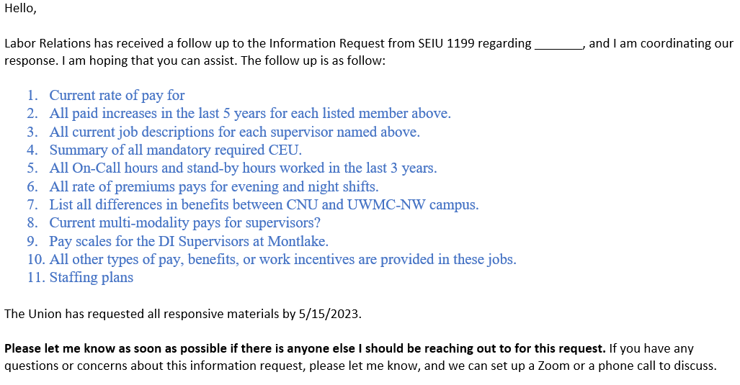
Information Request Examples

Slide 26
Responses

Slide 27
Contracting Out & Skimming ULPs
Contracting out
Bargaining unit work is transferred to employees of another employer.
Ex: Using an outside vendor.
Skimming
Bargaining unit work is transferred to employees of same employer, but outside the bargaining unit.
Ex: Using employees from a different campus.
*Bargaining unit work: Work that has historically been performed exclusively by bargaining unit employees.*

Slide 28
Ways to Prevent ULPs
Communication, Communication, Communication!
Understand collective bargaining obligations.
Remember Good Faith.
Demonstrate honesty and own mistakes.
Show respect.
Seek advice from your HRC or LR.

Slide 29
Questions?
Contact Info -- Labor Relations Office:
laborrel@uw.edu
206-543-6236
Website: hr.uw.edu/labor

